Slide 1



MediAssist

Slide 2



PROBLEM STATEMENT
Accessing and understanding medication information can be challenging for individuals, leading to potential health risks. Language barriers, complex dosages, dietary restrictions, and forgetfulness can hinder proper medication management.

Slide 3


SOLUTION
We aim to address this problem by creating a user-friendly Medi Assist webpage that utilizes OCR technology to extract medicine details from images.
Users can then access this information in multiple languages, listen to audio instructions, and share it with friends and family in document format.

Slide 4
SOLUTION
Additionally, our platform offers medication reminders and features an AI doctor chatbot for basic medical consultations, promoting safe and effective medication usage.

Slide 5

TECHNOLOGY STACK
HTML/CSS/JAVASCRIPT & REACT
Node.js & Database
Tesseract OCR
TEXT-TO-SPEECH (TTS) API
GOOGLE CLOUD TRANSLATION API
CLOUD STORAGE(AMAZON S3)
TIMER LIBRARIES(JAVASCRIPT)
NLP LIBRARY
CHATBOT FRAMEWORK

Slide 6
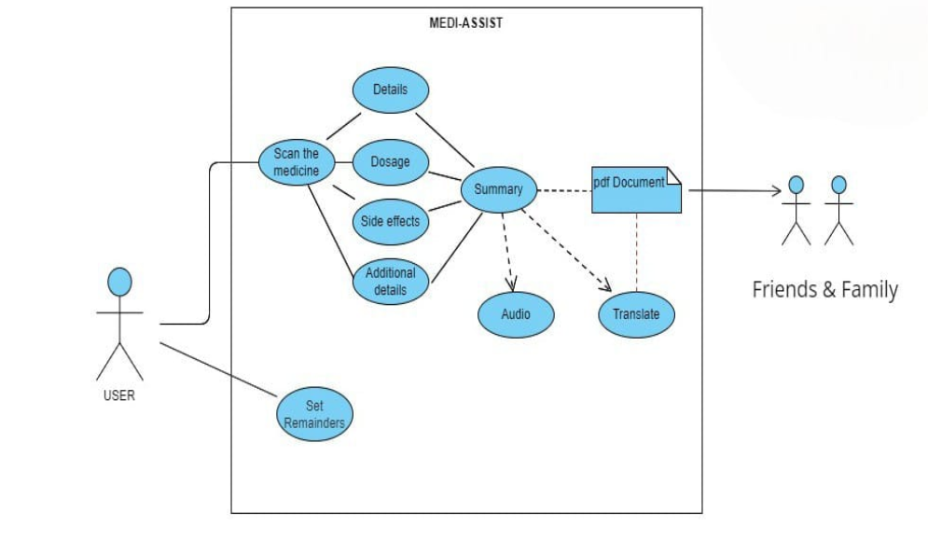

Slide 7
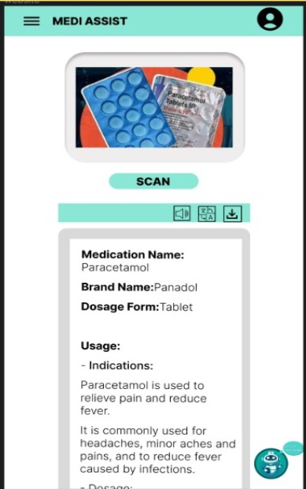
FEATURES
OCR Image Scanning
Multilingual Support
Text-to-Speech (TTS)
Medication Details
Side Effects Information
Document Sharing
Medication Reminders
AI Doctor Chatbot
User-Friendly Interface
Privacy and Security
Customization
Web and Mobile Access

Slide 8
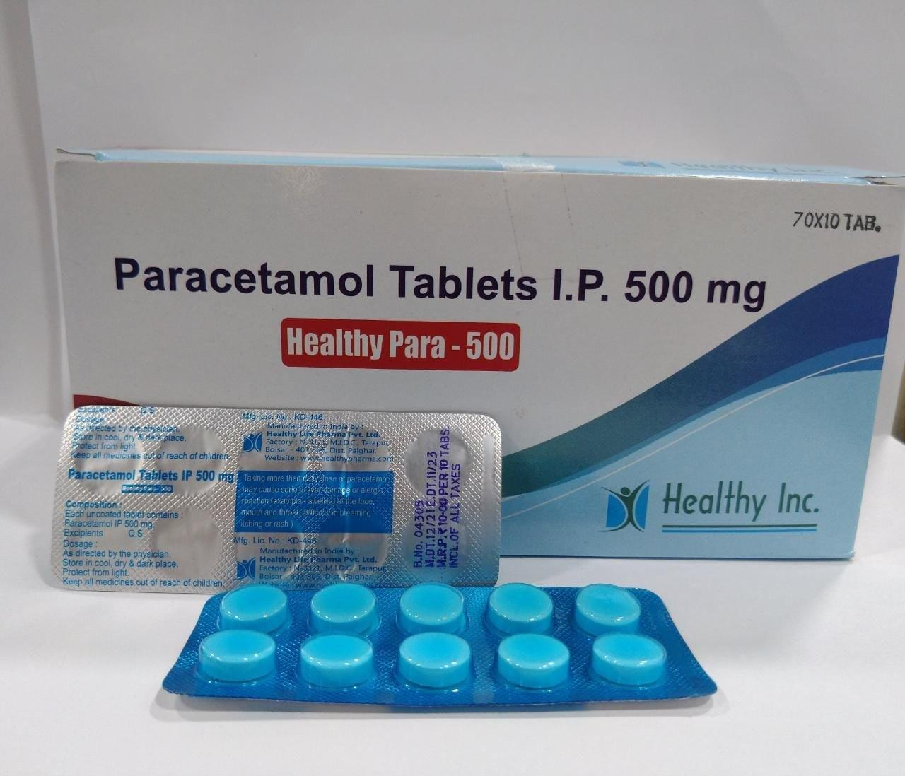
CURRENT STATE
OUTPUT
is a pain reliever and fever reducer. It is used to treat pain and fever. It is also used to reduce pain and swelling after surgery.
Details
Brand name: Tylenol, Panadol, Acetaminophen
Generic name: Paracetamol
Available forms: Tablet, capsule, liquid, suppository
Dosage: Adults and children 12 years and older: 325-650 mg every 4-6 hours, not to exceed 4,000 mg per day. Children 2-11 years: 10-15 mg/kg every 4-6 hours, not to exceed 5 doses per day. Children under 2 years: Ask a doctor.
Side effects: Nausea, vomiting, stomach pain, diarrhea, constipation, rash, itching, hives, swelling of the face, lips, or tongue, difficulty breathing, yellowing of the skin or eyes, dark urine, pale stools.
Ingredients: Paracetamol
Medicines not to take at the same time: Alcohol, blood thinners, antidepressants, seizure medications, methotrexate, probenecid, quinolone antibiotics, zidovudine.
Purchase
You can purchase Paracetamol online or at your local pharmacy.
References
Paracetamol

Slide 9

CONCLUSION
In conclusion, our project has successfully developed a model utilizing image processing and OCR techniques to extract text from medicine packaging. Leveraging Generative AI, we've generated detailed medication information. The next phase involves transforming this solution into a user-friendly mobile app, integrating real-time updates, personalized reminders, and user feedback mechanisms. This transition aims to enhance accessibility, providing a seamless experience for users and revolutionizing how people access and understand medication-related information.

Slide 10

